Slide 1
Chapter 3 figures

Slide 2
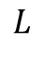
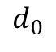
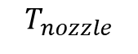
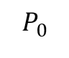
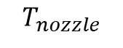
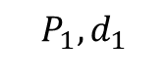
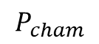
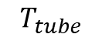
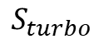
Low pressure cell
$$S_{turbo}$$
$$P_{1},d_{1}$$
$$T_{nozzle}$$
$$T_{nozzle}$$
$$d_{0}$$
$$L$$
$$P_{cham}$$
$$T_{tube}$$
$$P_{0}$$

Slide 3
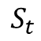
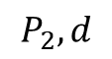
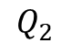
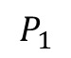
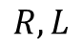
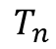
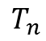
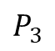
Low pressure cell
$$S_{t}$$
$$P_{2},d$$
$$T_{n}$$
$$T_{n}$$
$$Q_{2}$$
$$R,L$$
$$P_{3}$$
$$P_{1}$$

Slide 4

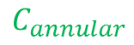
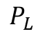
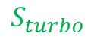

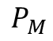
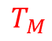
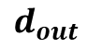
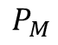
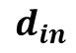
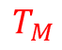
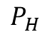

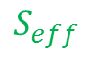
High pressure cell
$$S_{turbo}$$
$$P_{L}$$
$$P_{M}$$
$$P_{H}$$
$$P_{M}$$
$$T_{M}$$
$$T_{H}$$
$$T_{H}$$
$$T_{M}$$
$$C_{annular}$$
$$C_{annular}$$
$$d_{in}$$
$$d_{out}$$
$$S_{eff}$$

Slide 5

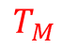


High pressure cell – showing plumes
$$S_{turbo}$$
$$P_{L}$$
$$P_{M}$$
$$P_{H}$$
$$T_{M}$$
$$T_{H}$$
$$T_{H}$$
$$T_{M}$$
$$C_{annular}$$
$$C_{annular}$$
$$d_{in}$$
$$d_{out}$$
$$S_{eff}$$

Slide 6
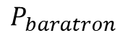
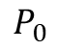
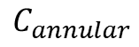
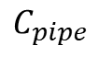
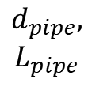
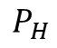
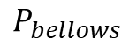
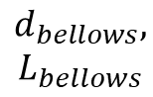
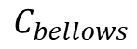
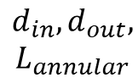
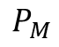
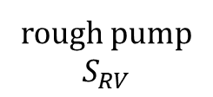
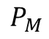
High pressure cell – showing rough line system & pressures
$$P_{M}$$
$$P_{bellows}$$
$$P_{baratron}$$
$$P_{0}$$
$$C_{annular}$$
$$C_{bellows}$$
$$C_{pipe}$$
3
$$P_{M}$$
3
rough pump
$$S_{RV}$$
$$P_{H}$$
$$d_{in},d_{out},$$
$$L_{annular}$$
$$d_{bellows},$$
$$L_{bellows}$$
$$d_{pipe},$$
$$L_{pipe}$$
Chamber wall

Slide 7
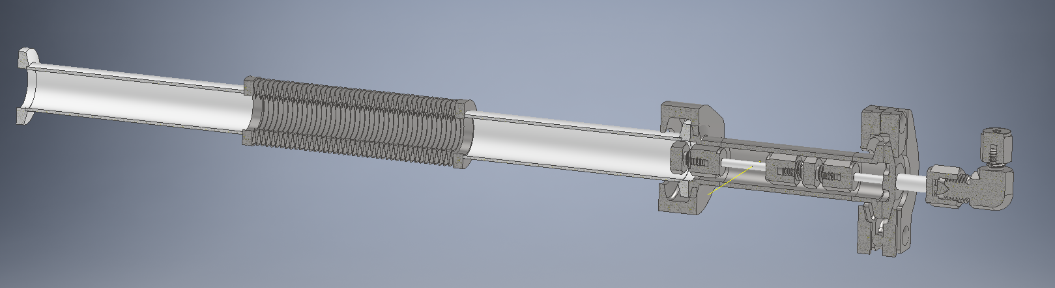
Chamber wall
Exhaust to RV pump
Edge-welded bellows
Interaction region
Gas source
laser
High pressure cell

Slide 8
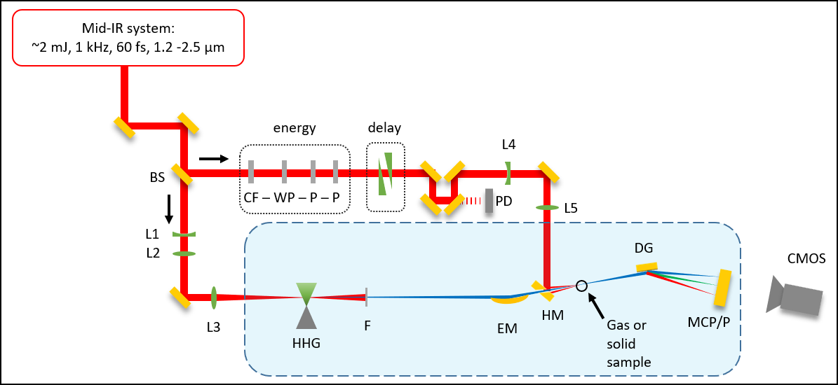
Beamline cartoon (image)
S
S

Slide 9


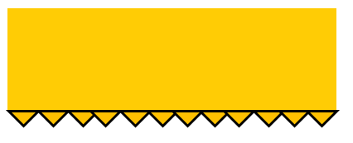
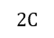
Beamline cartoon (editable)
Mid-IR system:
~2 mJ, 1 kHz, 60 fs, 1.2 -2.5 μm
energy
delay
S
L4
BS
CF – WP – P – P
S
W
PD
L5
L1
DG
L2
CMOS
I
L3
$$2C$$
HHG
F
EM
HM
SH
MCP/P

Slide 10
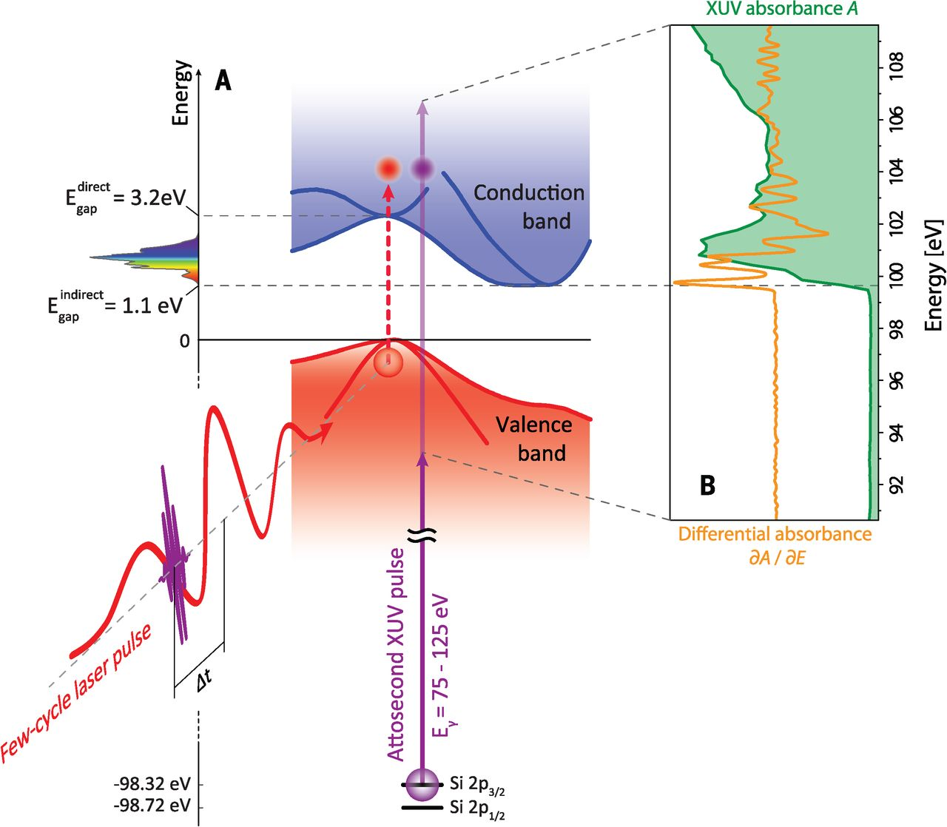

Slide 11
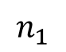
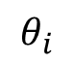
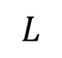










Fresnel geometry
a)
b)
$$L$$
$$T$$
$$I$$
interface
$$T_{F}$$
$$θ_{i}$$
normal
$$R$$
$$θ_{r}$$
$$θ_{t}$$
$$R$$
$$T$$
$$R_{F}$$
$$n_{1}$$
$$n_{2}$$

Slide 12
7.5 mm
3 mm
100 nm Ge
30 nm SiNx
500 μm Si
7.5 mm
3 mm
100 nm Ge
30 nm SiNx
500 μm Si
Notes:
Sample_Geometry.png

Slide 13


Slide 14
Knife edge cartoon
XUV
XUV detector

Slide 15




Knife edge cartoon
$$y$$
EM
$$z$$
$$x$$
XUV
XUV detector
$$z_{0}$$

Slide 16
Imaging the samples under vacuum
C
1 inch
HM
FM
SH
1 inch
L

Slide 17
Si, 260 nm
Si, one hole <200μm
“popped” 30 nm SiN

Slide 18



200 nm Si
200 nm Si
200 nm Si
IR-pumped areas
microscope image
Notes:
Figures from 2019-04-19 powerpoint presentation … “before pumping” was 4/09/2019 map1. “after pumping” was 4/10/2019 map1.

Slide 19



2D spectrometer image
Raw 2D image
Spectral lineout
Filtering
Delta-OD calculation
Delta-OD normalization
Average delta-OD
Energy calibration
Background subtraction, exposure time normalization, normalized spatial integration,

Slide 20
Finding temporal overlap in vacuum (or vented)
PA
HM
FM
GA
SH
L
C

Slide 21
Si, 260 nm
Si, one hole <200μm
“popped” 30 nm SiN
200 nm Si
200 nm Si
200 nm Si
IR-pumped areas
microscope image
Notes:
Figures from 2019-04-19 powerpoint presentation … “before pumping” was 4/09/2019 map1. “after pumping” was 4/10/2019 map1.

Slide 22


Slide 23

Germanium bandgap
M. Zürch, Nat. Commun. 8, no. 1, 15734 (2017)

Slide 24
Germanium bandgap
M. Zürch, Nat. Commun. 8, no. 1, 15734 (2017)

Slide 25
Germanium bandgap
M. Zürch, Nat. Commun. 8, no. 1, 15734 (2017)

Slide 26




$$λ=1.5 μm$$
Notes:
20 mW = 20 mJ = 3.6 * 10^12 W/cm2
35 mJ = 6.3 * 10^12 W/cm2

